Slide 1
The future of column-oriented data processing with Arrow and Parquet
Julien Le Dem, Principal Architect Dremio, VP Apache Parquet

Slide 2
Julien Le Dem
@J_
Julien
Architect at @DremioHQ
Formerly Tech Lead at Twitter on Data Platforms.
Creator of Parquet
Apache member
Apache PMCs: Arrow, Kudu, Incubator, Pig, Parquet

Slide 3
Agenda
Community Driven Standard
Interoperability and Ecosystem
Benefits of Columnar representation
On disk (Apache Parquet)
In memory (Apache Arrow)
Future of columnar

Slide 4
Community Driven Standard
Parquet: Common need for on disk columnar.
Arrow: Common need for in memory columnar.
Arrow building on the success of Parquet.
Benefits:
Share the effort
Create an ecosystem
Standard from the start

Slide 5
Arrow goals
Well-documented and cross language compatible
Designed to take advantage of the modern CPU
Embeddable in execution engines, storage layers, etc.
Interoperable

Slide 6
Interoperability and Ecosystem
Before
With Arrow
High Interoperability cost:
High Performance Sharing & Interchange
Each system has its own internal memory format
70-80% CPU wasted on marshalling
Duplication and unnecessary conversions
All systems utilize the same memory format
No overhead for cross-system communication
Shared functionality (Parquet-to-Arrow reader)

Slide 7

Benefits of Columnar formats
@EmrgencyKittens

Slide 8
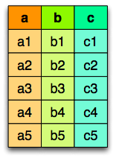
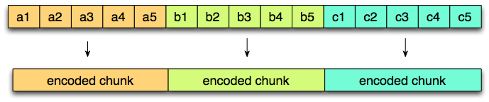
Columnar layout
Logical table
representation
Row layout
Column layout

Slide 9
On Disk and in Memory
Different trade offs
On disk: Storage.
Accessed by multiple queries.
Priority to I/O reduction (but still needs good CPU throughput).
Mostly Streaming access.
In memory: Transient.
Specific to one query execution.
Priority to CPU throughput (but still needs good I/O).
Streaming and Random access.

Slide 10
Parquet on disk columnar format
Nested data structures
Compact format:
type aware encodings
better compression
Optimized I/O:
Projection push down (column pruning)
Predicate push down (filters based on stats)

Slide 11
Access only the data you need
Read only the data you need!
Columnar
Statistics

Slide 12
Arrow in memory columnar format
Nested Data Structures
Maximize CPU throughput
Pipelining
SIMD
cache locality
Scatter/gather I/O

Slide 13
Focus on CPU Efficiency
Arrow
Memory Buffer
Cache Locality
Super-scalar & vectorized operation
Minimal Structure Overhead
Constant value access
With minimal structure overhead
Operate directly on columnar data

Slide 14
Arrow Messages, RPC & IPC

Slide 15
Common Message Pattern
Schema Negotiation
Logical Description of structure
Identification of dictionary encoded Nodes
Dictionary Batch
Dictionary ID, Values
Record Batch
Batches of records up to 64K
Leaf nodes up to 2B values
Schema Negotiation
0..N Batches
Dictionary Batch
Record Batch
1..N Batches
Record Batch
Record Batch

Slide 16
Multi-system IPC

Slide 17
Summary and Future

Slide 18
Current activity:
Spark Integration (SPARK-13534)
Dictionary encoding (ARROW-542)
Time related types finalization (ARROW-617)
Arrow REST API
Bindings:
C, Ruby (ARROW-631)
JavaScript (ARROW-541)

Slide 19
Some results
- PySpark Integration:
53x speedup (IBM spark work on SPARK-13534)
http://s.apache.org/arrowstrata1
- Streaming Arrow Performance
7.75GB/s data movement
http://s.apache.org/arrowstrata2
- Arrow Parquet C++ Integration
4GB/s reads
http://s.apache.org/arrowstrata3
- Pandas Integration
9.71GB/s
http://s.apache.org/arrowstrata4

Slide 20
Get Involved
Join the community
dev@{arrow,parquet}.apache.org
Slack:
https://apachearrowslackin.herokuapp.com/
https://parquet-slack-invite.herokuapp.com/
http://{arrow,parquet}.apache.org
Follow @Apache{Parquet,Arrow}

